Slide 1
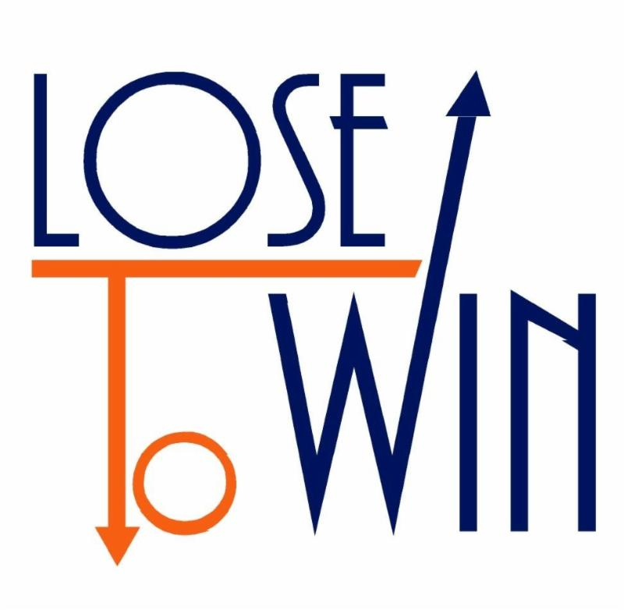

Slide 2
LOSING TO WIN
Matthew 16:24-26
²⁴ Then Jesus said to His disciples,
“If any of you wants to be My follower,
You must give up your own way,
Take up your cross, and follow me.

Slide 3
LOSING TO WIN
Matthew 16:24-26
25 If you try to hang on to your life,
You will lose it.
But if you give up your life for my sake,
You will save it.

Slide 4
LOSING TO WIN
Matthew 16:24-26
26 And what do you benefit
If you gain the whole world
But lose your own soul?
Is anything worth more than your soul?

Slide 5
LOSING TO WIN
I. HANGING ON IS LOSING (MATT. 16:25a)
If you try to hang on to your life,
You will lose it.

Slide 6
LOSING TO WIN
²⁸ Then Agrippa said to Paul,
“You almost persuade me to become a Christian.”
Acts 26:28

Slide 8
LOSING TO WIN
II. LOSING IS FINDING (MATT. 16:25b)
But if you give up your life for my sake,
You will save it.

Slide 9
LOSING TO WIN
And everyone who has given up houses or brothers or sisters or father or mother or children or property, for my sake, will receive a hundred times as much in return and will inherit eternal life.
Matt. 19:29

Slide 11
LOSING TO WIN
III. LOSS IS GAIN (MATT. 16:26)
And what do you benefit
If you gain the whole world
But lose your own soul?
Is anything worth more than your soul?

Slide 12
LOSING TO WIN
⁷ But what things were gain to me,
these I have counted loss for Christ.
⁸ Yet indeed I also count all things loss for the excellence of the knowledge of Christ Jesus my Lord, for whom I have suffered the loss of all things, and count them as rubbish, that I may gain Christ…
Phil. 3:7-8

