Slide 1
PREPARE FOR A NEW SEASON
“He told them this parable:
"No one tears a patch from a new garment
and sews it on an old one. I
f he does,
he will have torn the new garment,
and the patch from the new will not match the old.
Luke 5:36

Slide 2
PREPARE FOR A NEW SEASON
37 And no one pours new wine into old wineskins.
If he does, the new wine will burst the skins,
the wine will run out
nd the wineskins will be ruined.
Luke 5:37

Slide 3
PREPARE FOR A NEW SEASON
38 No, new wine must be poured
into new wineskins (renewed).
39 And no one after drinking old wine
wants the new, for he says,
`The old is better.’"
Luke 5:38-39

Slide 4
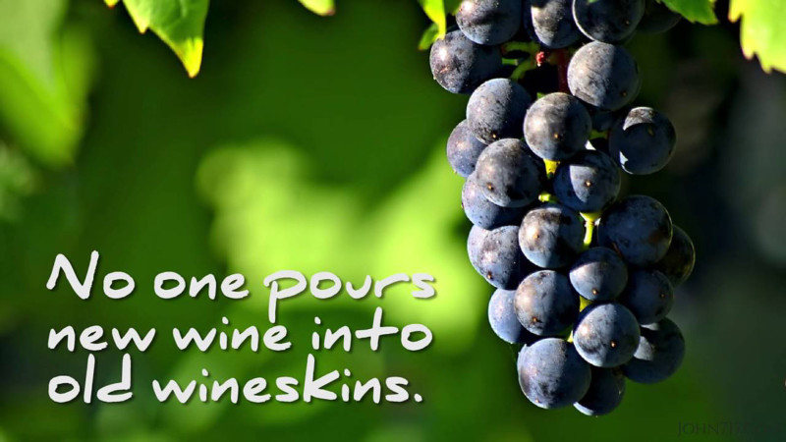

Slide 5
PREPARE FOR A NEW SEASON
"If the world is to be brought to order,
my nation must first be changed.
If my nation is to be changed,
my hometown must be made over.
f my hometown is to be reordered,
my family must first be set right.
If my family is to be regenerated,
I myself must first be."

Slide 6
PREPARE FOR A NEW SEASON
“He who has an ear, let him hear
what the Spirit is saying
to the churches.”
Rev. 2:11

Slide 7
PREPARE FOR A NEW SEASON
“Enlarge your house; build an addition.
Spread out your home, and spare no expense!
For you will soon be bursting at the seams.”
Isa.54: 2-3a

Slide 8
PREPARE FOR A NEW SEASON
I. We Choose To Let Go of the Old (Isa. 43:18-19)
“Do not remember the former things,
Nor consider the things of old.
For I am about to do something new.
See, I have already begin! Do you not see it?
I will make a pathway through the wilderness.
I will create rivers in the dry wasteland.”

Slide 9
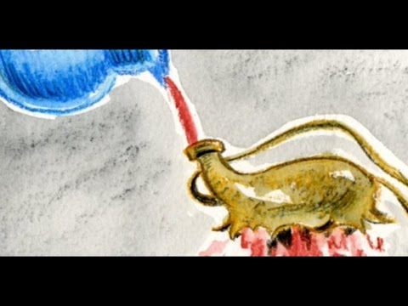

Slide 10
PREPARE FOR A NEW SEASON
II. We Need A Fresh Anointing (1 John 2:20 AMP)
But you have an anointing from the Holy One [you have been set apart, specially gifted and prepared by the Holy Spirit], and all of you know [the truth because He teaches us, illuminates our minds, and guards us from error].

Slide 11
PREPARE FOR A NEW SEASON
I have been anointed with fresh oil.
Ps. 97:10b
You anoint my head with oil;
My cup runs over.
Ps. 23:5

Slide 12


