Slide 1


Slide 2
PHILIP THE _______
²⁶ Remember, dear brothers and sisters, that few of you were wise in the world’s eyes or powerful or wealthy when God called you.
²⁷ Instead, God chose things the world considers foolish in order to shame those who think they are wise. And he chose things that are powerless to shame those who are powerful.
1 Cor. 1:26-27

Slide 3
PHILIP THE _______
³ And so, brothers,
select seven men who are well respected
and are full of the Spirit and wisdom.
We will give them this responsibility.
Acts 6:3

Slide 4
PHILIP THE _______
I. PHILIP THE DEACON (ACTS 6:5)
⁵ Everyone liked this idea,
and they chose the following:
Stephen (a man full of faith and the Holy Spirit),
Philip, Procorus, Nicanor, Timon,
Parmenas, and Nicolas of Antioch
(an earlier convert to the Jewish faith).

Slide 5
PHILIP THE _______
²³ “The master said,
‘Well done, my good and faithful servant.
You have been faithful
in handling this small amount,
so now I will give you many more responsibilities. Let’s celebrate together!’
Matt. 26:23

Slide 6
PHILIP THE _______
      Qualifications of a deacon (1 Tim. 3:8-9)
…deacons must be well respected and have integrity. They must not be heavy drinkers or dishonest with money.
⁹ They must be committed to the mystery of the faith now revealed and must live with a clear conscience.

Slide 7
PHILIP THE _______
II. PHILIP THE EVANGELIST (Acts 21:8)
“Leaving the next day we reached Caesarea
and stayed at the house of Philip the evangelist,
one of the Seven.”

Slide 8
PHILIP THE _______
¹¹ Now these are the gifts Christ gave to the church: the apostles, the prophets, the evangelists, and the pastors and teachers.
¹² Their responsibility is to equip God’s people to do his work and build up the church, the body of Christ.

Slide 9
PHILIP THE _______
The Revival at Samaria (Acts 8:4-8)
⁴ But the believers who were scattered preached the Good News about Jesus wherever they went.
⁵ Philip, for example, went to the city of Samaria and told the people there about the Messiah.

Slide 10
PHILIP THE _______
⁶ Crowds listened intently to Philip because they were eager to hear his message and see the miraculous signs he did.
⁷ Many evil spirits were cast out, screaming as they left their victims. And many who had been paralyzed or lame were healed
⁸ So there was great joy in that city.

Slide 11
PHILIP THE _______
      Philip and the Ethiopian Eunuch (Acts 8:26-29)
²⁶ As for Philip, an angel of the Lord said to him, “Go south down the desert road that runs from Jerusalem to Gaza.”
²⁷ So he started out, and he met the treasurer of Ethiopia, a eunuch of great authority under the Kandake, the queen of Ethiopia. The eunuch had gone to Jerusalem to worship,

Slide 12
PHILIP THE _______
²⁸ and he was now returning.
Seated in his carriage,
he was reading aloud
from the book of the prophet Isaiah.
²⁹ The Holy Spirit said to Philip,
“Go over and walk along beside the carriage.”

Slide 13
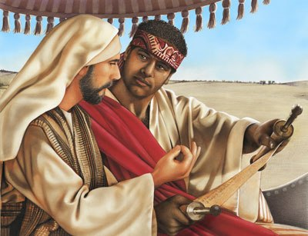

Slide 14
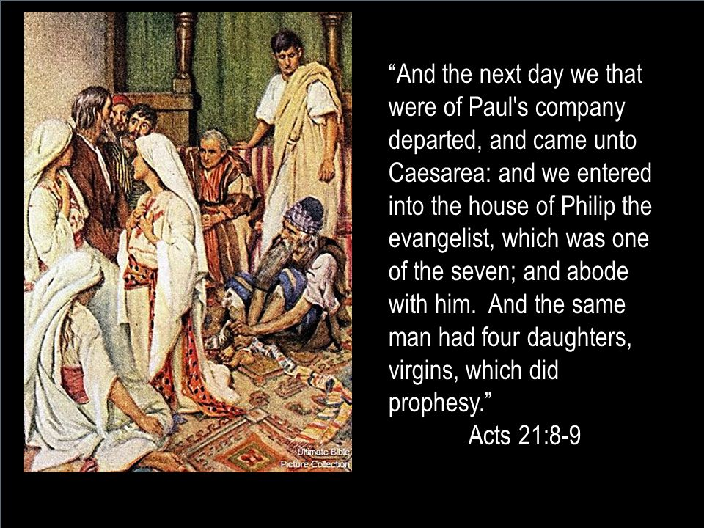
III. PHILIP THE FATHER

