Slide 1
The Story of Stephen
Satanic Opposition to the Church
1. Inward dissention (Acts 6:1)
But as the believers rapidly multiplied, there were rumblings of discontent. The Greek-speaking believers complained about the Hebrew-speaking believers, saying that their widows were being discriminated against in the daily distribution of food.

Slide 2
The Story of Stephen
Satanic Opposition to the Church
2. Outward persecution (Acts 6:11-12)
¹¹ So they persuaded some men to lie about Stephen, saying, “We heard him blaspheme Moses, and even God.”
¹² This roused the people, the elders, and the teachers of religious law. So they arrested Stephen and brought him before the high council.

Slide 3
The Story of Stephen
THE CHURCH GETS ORGANIZED (6:2-8)
² So the Twelve called a meeting of all the believers. They said,
“We apostles should spend our time
teaching the word of God,
not running a food program…”

Slide 4
The Story of Stephen
The results of wisdom and administration:
God’s message continued to spread
The number of believers greatly increased
many of the Jewish priests were converted
Acts 6:7

Slide 5
The Story of Stephen
AS STEPHEN GREW – HIS ANOINTING GREW
Stephen, a man full of God’s grace and power,
performed amazing miracles
and signs among the people.
Acts 6:8

Slide 6
The Story of Stephen
I. STEPHEN WAS FULL OF THE WORD (ACTS 7)
This was Stephen’s reply:
“Brothers and fathers, listen to me.
Our glorious God appeared to our ancestor
Abraham in Mesopotamia
before he settled in Haran
Acts 7:2

Slide 7
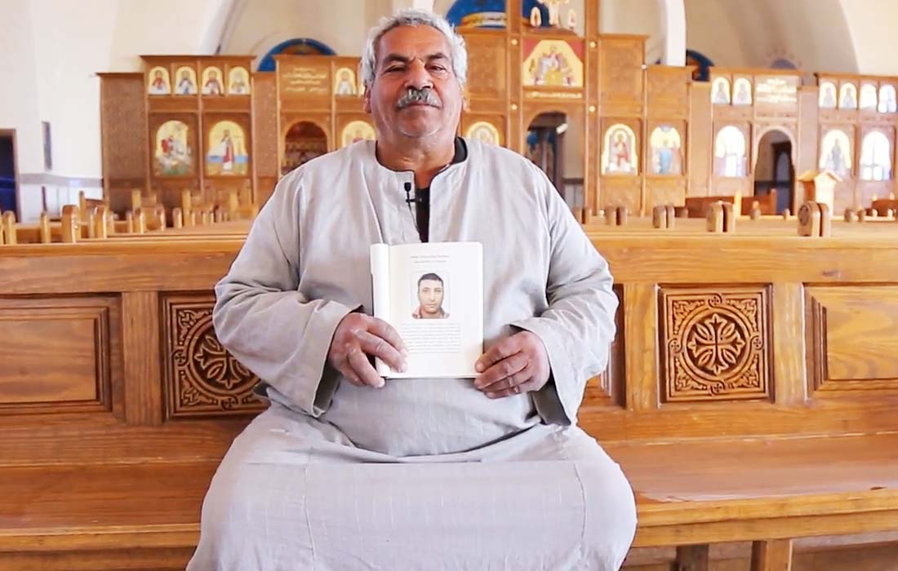

Slide 8
The Story of Stephen
II. HE WAS FULLY COMMITTED (ACTS 7:55-56)
⁵⁵ But Stephen , full of the Holy Spirit,
gazed steadily into heaven
and saw the glory of God,
and he saw Jesus
standing in the place of honor
at God’s right hand.

Slide 9
The Story of Stephen
⁵⁶ And he told them,
“Look, I see the heavens opened
and the Son of Man standing
in the place of honor
at God’s right hand!”

Slide 10
The Story of Stephen
III. HE WAS FULL OF COMPASSION (ACTS 7:57-60)
⁵⁷ Then they put their hands over their ears and began shouting. They rushed at him
⁵⁸ and dragged him out of the city and began to stone him. His accusers took off their coats and laid them at the feet of a young man named Saul.

Slide 11
The Story of Stephen
⁵⁹ As they stoned him,
Stephen prayed,
“Lord Jesus, receive my spirit.”
⁶⁰He fell to his knees, shouting,
“Lord, don’t charge them with this sin!”
And with that, he died.

