Slide 1
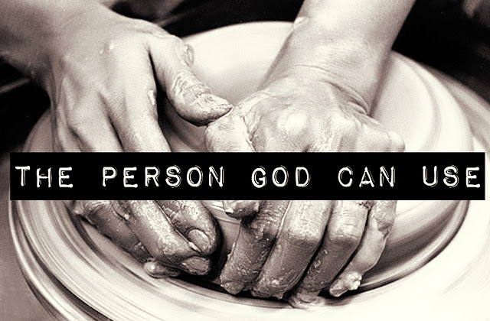

Slide 2
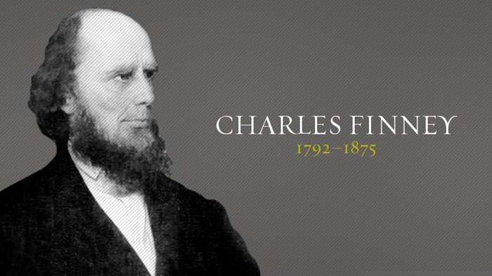

Slide 3
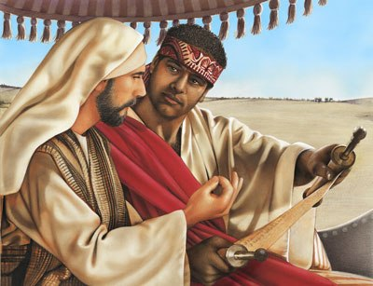

Slide 4
THE PERSON GOD CAN USE
I. THEY LISTENED TO THE VOICE OF THE SPIRIT
²⁹ The Holy Spirit said to Philip,
“Go over and walk along beside the carriage.”
Acts 8:29

Slide 5
THE PERSON GOD CAN USE
³ And so, brothers, select seven men
who are well respected and
are full of the Spirit and wisdom.
We will give them this responsibility.
Acts 6:3

Slide 6
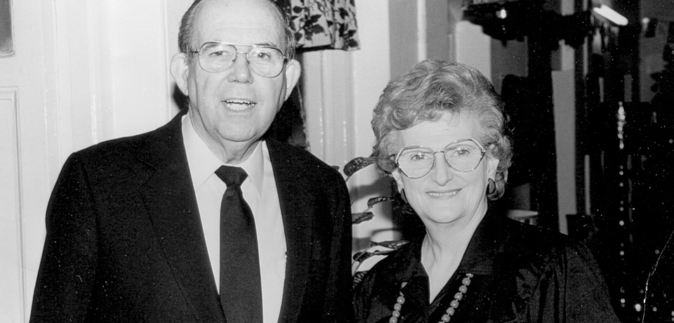

Slide 7
THE PERSON GOD CAN USE
II. THEY’RE PEOPLE OF THE WORD (Acts 8:34-35)
³⁴ The eunuch asked Philip,
“Tell me, was the prophet talking about himself
or someone else?”
³⁵ So beginning with this same Scripture,
Philip told him the Good News about Jesus.

Slide 8
THE PERSON GOD CAN USE
¹⁵ Work hard (study)
so you can present yourself to God
and receive his approval.
Be a good worker,
one who does not need to be ashamed
and who correctly explains the word of truth.
2 Tim. 2:15

Slide 9
THE PERSON GOD CAN USE
“He was led like a sheep to the slaughter.
And as a lamb is silent before the shearers,
he did not open his mouth.
³³ He was humiliated and received no justice.
Who can speak of his descendants?
For his life was taken from the earth.”
Acts 8:32-33

Slide 10
THE PERSON GOD CAN USE
III. THEY HAVE A BURDEN FOR SOULS (Acts 8:4-5)
⁴ But the believers who were scattered preached the Good News about Jesus wherever they went.
⁵ Philip, for example, went to the city of Samaria and told the people there about the Messiah.

Slide 11
THE PERSON GOD CAN USE
⁶ Crowds listened intently to Philip because they were eager to hear his message and see the miraculous signs he did.
⁷ Many evil spirits were cast out, screaming as they left their victims. And many who had been paralyzed or lame were healed.
⁸ So there was great joy in that city.
Acts 8:6-8

Slide 12
THE PERSON GOD CAN USE
¹⁴ When the apostles in Jerusalem heard that the people of Samaria had accepted God’s message, they sent Peter and John there.
Acts 8:14

