Slide 1
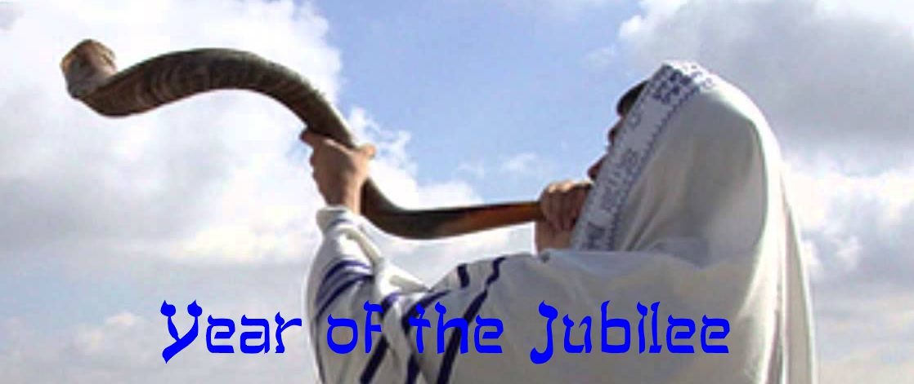

Slide 2
SUBDUE THE LAND
Therefore, since we are surrounded
by such a huge crowd of witnesses
to the life of faith,
let us strip off every weight that slows us down,
especially the sin that so easily trips us up.
And let us run with endurance
the race God has set before us. (Heb. 12:1)

Slide 3
SUBDUE THE LAND
² We do this by keeping our eyes on Jesus,
the champion who initiates and perfects our faith.
Because of the joy awaiting Him,
He endured the cross, disregarding its shame.
Now He is seated in the place of honor
beside God’s throne.
Heb. 12:2

Slide 4
JUBILEE SUNDAY
SUBDUE THE LAND
² “Moses my servant is dead. Therefore, the time has come for you to lead these people, the Israelites, across the Jordan River into the land I am giving them.
³ I promise you what I promised Moses: ‘Wherever you set foot, you will be on land I have given you—
Josh. 12-3

Slide 6
JUBILEE SUNDAY
SUBDUE THE LAND
THE CAPTAIN OF THE LORD’S HOST (Josh. 5)
¹³ When Joshua was near the town of Jericho, he looked up and saw a man standing in front of him with sword in hand. Joshua went up to him and demanded, “Are you friend or foe?”
¹⁴ “Neither one,” he replied. “I am the Captain of the Lord’s army.”

Slide 7
JUBILEE SUNDAY
SUBDUE THE LAND
At this, Joshua fell with his face to the ground in reverence. “I am at your command,” Joshua said. “What do you want your servant to do?”
¹⁵ The commander of the Lord’s army replied, “Take off your sandals, for the place where you are standing is holy.” And Joshua did as he was told.
Josh. 5:13-15

Slide 8
JUBILEE SUNDAY
SUBDUE THE LAND
When Joshua was an old man,
the Lord said to him,
“You are growing old,
and much land remains to be conquered.
Josh. 13:1

Slide 9
JUBILEE SUNDAY
SUBDUE THE LAND
I. DRIVE OFF THE GIANTS (Josh. 14:10-12)
¹⁰ “Now, as you can see, the Lord has kept me alive and well as He promised for all these forty-five years since Moses made this promise—even while Israel wandered in the wilderness. Today I am eighty-five years old.

Slide 10
JUBILEE SUNDAY
SUBDUE THE LAND
¹¹ I am as strong now as I was when Moses sent me on that journey, and I can still travel and fight as well as I could then.

Slide 11
JUBILEE SUNDAY
SUBDUE THE LAND
¹² So give me the hill country that the Lord promised me. You will remember that as scouts we found the descendants of Anak living there in great, walled towns.
But if the Lord is with me,
I will drive them out of the land,
just as the Lord said.”

Slide 12
JUBILEE SUNDAY
SUBDUE THE LAND
II. CROPS –VINEYARDS - HOUSES (Deut. 6:10-11)
¹⁰ “The Lord your God will soon bring you into the land he swore to give you when he made a vow to your ancestors Abraham, Isaac, and Jacob. It is a land with large, prosperous cities that you did not build.

Slide 13
JUBILEE SUNDAY
SUBDUE THE LAND
¹¹ The houses will be richly stocked
with goods you did not produce.
You will draw water from cisterns you did not dig,
and you will eat from vineyards and olive trees
you did not plant.

Slide 14
JUBILEE SUNDAY
SUBDUE THE LAND
“Set this year apart as holy,
a time to proclaim freedom
throughout the land
for all who live there.
It will be a jubilee year for you…”
Lev. 25:10

Slide 15
JUBILEE SUNDAY
SUBDUE THE LAND
¹¹ Now you should finish what you started.
Let the eagerness you showed in the beginning
be matched now by your giving.
Give in proportion to what you have.
2 Cor. 8:11-12

Slide 16
JUBILEE SUNDAY
SUBDUE THE LAND
¹² Whatever you give is acceptable
if you give it eagerly.
And give according to what you have,
not what you don’t have.
2 Cor. 8:12

