Slide 1
BE HOLY!
¹³ So prepare your minds for action and exercise self-control. Put all your hope in the gracious salvation that will come to you when Jesus Christ is revealed to the world.
1 PETER 1:13

Slide 2
BE HOLY!
¹⁴ So you must live as God’s obedient children. Don’t slip back into your old ways of living to satisfy your own desires. You didn’t know any better then.
¹⁵ But now you must be holy in everything you do, just as God who chose you is holy.
1 PETER 1:14 -15

Slide 3
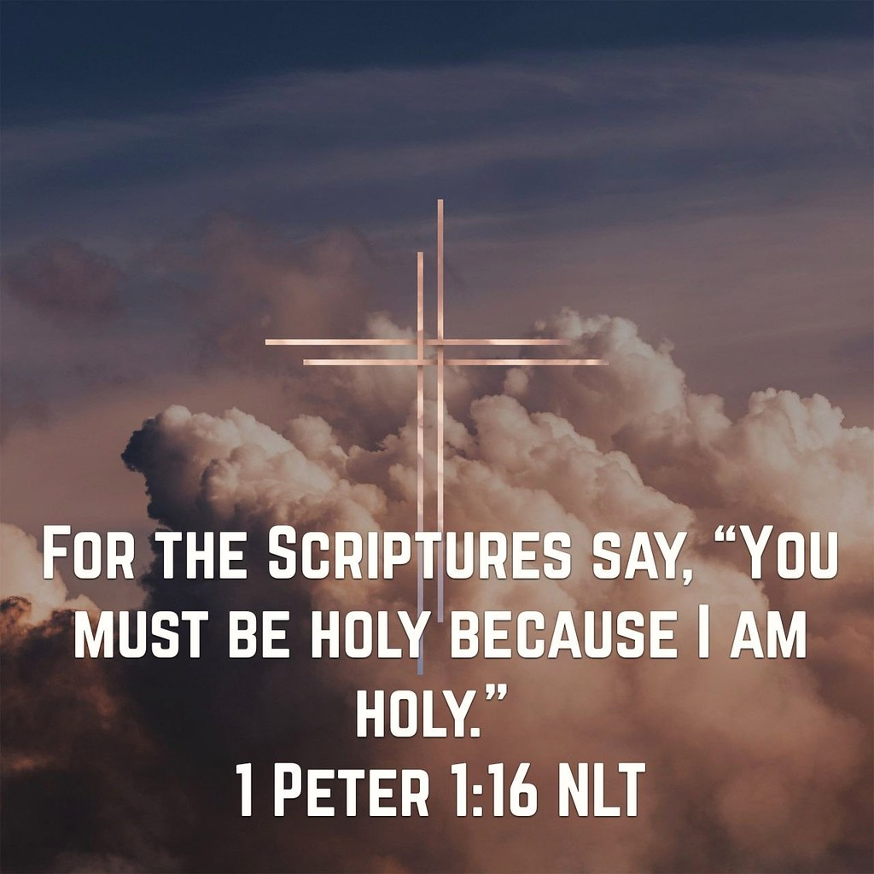

Slide 4
BE HOLY!
³ All praise to God, the Father of our Lord Jesus Christ. It is by His great mercy that we have been born again, because God raised Jesus Christ from the dead. Now we live with great expectation,
1 PETER 1:3

Slide 5
BE HOLY!
I. GOD IS HOLY (1 PET. 1:15)
¹⁵ But now you must be holy
in everything you do,
just as God who chose you is holy.

Slide 6
BE HOLY!
⁴ When the Lord saw Moses coming to take a closer look, God called to him from the middle of the bush, “Moses! Moses!”
“Here I am!” Moses replied.
EXODUS 3:4

Slide 7
BE HOLY!
⁵ “Do not come any closer,”
the Lord warned.
“Take off your sandals,
for you are standing on holy ground.
EXODUS 3:5

Slide 8
BE HOLY!
It was in the year King Uzziah died that I saw the Lord. He was sitting on a lofty throne, and the train of his robe filled the Temple.
² Attending Him were mighty seraphim, each having six wings. With two wings they covered their faces, with two they covered their feet, and with two they flew.
ISAIAH 6:1-2

Slide 9
BE HOLY!
(ISAIAH 6:3-4)
³ They were calling out to each other,
“Holy, holy, holy is the Lord of Heaven’s Armies!
The whole earth is filled with his glory!”
⁴ Their voices shook the Temple to its foundations, and the entire building was filled with smoke.

Slide 10
BE HOLY!
(REV. 4:8)
Each of these living beings had six wings, and their wings were covered all over with eyes, inside and out. Day after day and night after night they keep on saying,
“Holy, holy, holy is the Lord God, the Almighty—
the One who always was, who is, and who is still to come.”

Slide 11
BE HOLY!
THE CERTAINTY OF DIVINE JUDGMENT
Yes, each of us will give a personal account to God.
Romans 14:12

Slide 12
BE HOLY!
II. THE GOAL IS HOLINESS (1 PET. 1:16)
¹⁶ For the Scriptures say,
“You must be holy
because I am holy.”

Slide 13
BE HOLY!
And so, dear brothers and sisters, I plead with you to give your bodies to God because of all He has done for you. Let them be a living and holy sacrifice—the kind He will find acceptable. This is truly the way to worship Him.
.ROM. 12:1

Slide 14
BE HOLY!
Don’t copy the behavior and customs of this world, but let God transform you into a new person by changing the way you think. Then you will learn to know God’s will for you, which is good and pleasing and perfect
ROM. 12:2

Slide 15
BE HOLY!
(1 PETER 2:21-24)
²¹ For God called you to do good,
even if it means suffering,
just as Christ suffered for you.
He is your example, and
you must follow in His steps.

Slide 16
BE HOLY!
(1 PETER 2:21-24)
²² He never sinned,
nor ever deceived anyone.
²³ He did not retaliate when he was insulted,
nor threaten revenge when he suffered.
He left his case in the hands of God,
who always judges fairly.

Slide 17
BE HOLY!
(1 PETER 2:21-24)
²⁴ He personally carried our sins
in His body on the cross
so that we can be dead to sin
and live for what is right.
By His wounds
you are healed.

Slide 18
BE HOLY!
III. GRACE BRIDGES THE GAP (1 PET. 1:17-20)
¹⁷ And remember that the heavenly Father to whom you pray has no favorites. He will judge or reward you according to what you do. So you must live in reverent fear of him during your time here as “temporary residents.”

Slide 19
BE HOLY!
¹⁸ For you know that God paid a ransom to save you from the empty life you inherited from your ancestors. And it was not paid with mere gold or silver, which lose their value.

Slide 20
BE HOLY!
¹⁹ It was the precious blood of Christ, the sinless, spotless Lamb of God.
²⁰ God chose Him as your ransom long before the world began, but now in these last days He has been revealed for your sake.

Slide 21
BE HOLY!
We are all infected and impure with sin.
When we display our righteous deeds,
they are nothing but filthy rags.
Like autumn leaves, we wither and fall,
and our sins sweep us away like the wind .
Isa. 64:6

