Slide 1
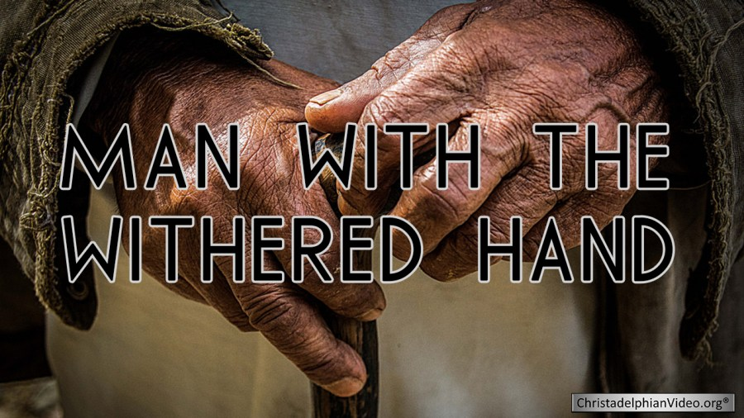

Slide 2
THE WITHERED HAND
THE CONDITION OF THE MAN Jesus went into the synagogue again and noticed a man with a deformed hand.
MARK 3:1

Slide 3
THE WITHERED HAND
II. THE COMPASSION OF JESUS (MARK 3:2-5)
² Since it was the Sabbath,
Jesus’ enemies watched him closely.
If he healed the man’s hand, they

Slide 4
THE WITHERED HAND
³ Jesus said to the man
with the deformed hand,
“Come and stand
in front of everyone.”

Slide 5
THE WITHERED HAND
⁴ Then he turned to his critics and asked,
“Does the law permit good deeds on the Sabbath, or is it a day for doing evil?
Is this a day to save life or to destroy it?” But they wouldn’t answer him.

Slide 6
THE WITHERED HAND
⁵ He looked around at them angrily
and was deeply saddened
by their hard hearts.
Then he said to the man,
“Hold out your hand.”
So the man held out his hand,
and it was restored!

Slide 7
THE WITHERED HAND
III. THE COMPARISON TO US
For everyone has sinned; we all fall short of God’s glorious standard.
ROM. 3:23

Slide 8
THE WITHERED HAND
The temptations in your life are no different from what others experience. And God is faithful. He will not allow the temptation to be more than you can stand. When you are tempted, he will show you a way out so that you can endure. (1 COR. 10:13)

Slide 9
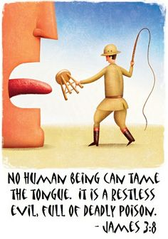

Slide 10
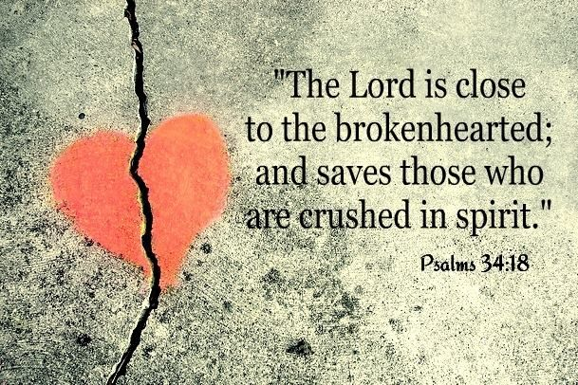

Slide 11


Slide 12
THE WITHERED HAND
6 This is why I remind you to fan into flames the spiritual gift God gave you when I laid my hands on you.
7 For God has not given us a spirit of fear and timidity, but of power, love, and self-discipline.
2 TIM. 1:6-7

Slide 13


Slide 14
